Slide 1
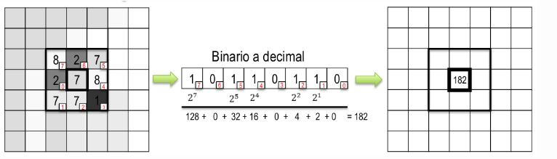
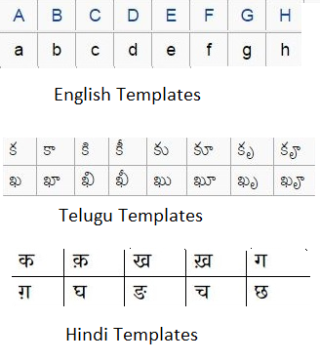
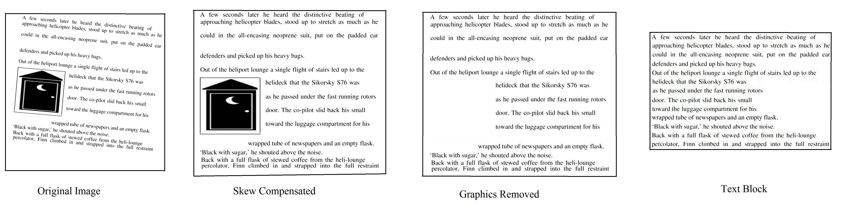
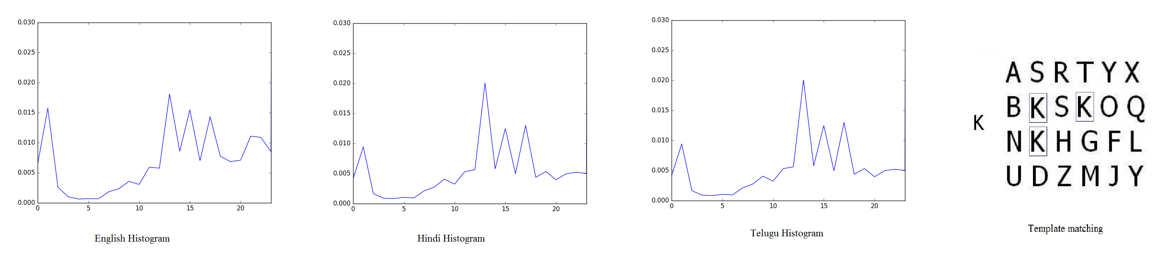
Texture, Template matching approaches for Language Detection in document images.
Deepak Jannarapu, Nallagatla Manikanta, Vinod Pankajakshan IIT Roorkee
Abstract
Results
The problem of recognising the language of a document image has large number of applications in many fields like document analysis, as an initial step for optical character recognition. We analysed and improved two approaches for language detection- texture and template matching. Local binary patterns are used or texture features and for template matching character templates for three languages English, Hindi, Telugu are handpicked from respective scripts. Comparing both approaches, texture features, achieved over 95% accuracy on the classification of document images from 3 languages.
.
The color images used were taken as screenshots from english, hindi, telugu content pdfs. 80 document examples were chosen for each of: english, hindi and telugu. Images contain graphics, and would resemble reasonably closely the output from a document segmentation system. Also Foreign characters, numerals and italicized text were present in many of the images. Figure below shows step by step processing of a sample image used in the experiments. The images were divided into 60 training and 20 test images per language. For non text removal, connected component of more than 2.25 times average area of a character is removed. For template matching, 52 for english, 425 for hindi, 756 for telugu template characters are hand picked. The texture features approach achieved over 95% accuracy on the classification of 60 test document images from 3 languages are very promising over 73% accuracy with template matching features.
fig 2: Method.
Then LBP Histograms are calculated and normalized for the features. We used chi square distance with the features of train images for classifying the test image.
Introduction
The world we live in is becoming increasingly multilingual and, at the same time, increasingly automated. Hence the need of automatic language identification is increasing. Various methods have been developed for language detections. But among these 3 methods namely texture analysis, template matching and statistical analysis are found to be accurate and feasible. In texture analysis, documents are classified on the basis of texture features known as local binary patterns. The template matching identifies textual symbols in the test images. The details about these methods are explained in the further sections.
Uniqueness
fig 3: Local Binary Pattern example
Texture features approach is rotation invariant as local binary patterns are rotation invariant. As we are using texture for language classification texture approach is independent on number of lines work, size of image. This approach is also working for scanned documents also which has various applications like indexing, digitalizing a hard copy.
Template matching:
Templates for characters of three languages English, Hindi, Telugu are handpicked from their scripts. Then after performing image processing as above, the instances of these templates are searched in test document images. Sample of templates for each language are shown in below figure 1.
Conclusion and Future Study
We analysed and improved two methods of language detection in scanned documents for three different languages. We have also found the effectiveness of texture analysis over template matching. Our system can also overcome noise which is in the form of moderate skew, numerals, foreign characters, illustrations, and blurred or fragmented characters. But main drawback of texture approach is that it is sensitive for font size in training images. The next step in our research is to link this algorithm with appropriate language character identification. Number of languages to be identified can also be increased. system need to overcome the sensitivity of font size.
fig 1: Character Templates.
fig 4: Image Processing sample result
Methods
After image processing step shown in figure 2, respective features are extracted from the image.
Texture approach:
Using local binary patterns texture features are extracted. To calculate the LBP value for a pixel in the gray scale image, we compare the central pixel value with the neighbouring pixel values. Since there are 8 neighbouring pixels – for each pixel, we will perform 8 comparisons. The results of the comparisons are stored in a 8-bit binary array. I The whole process is shown in the figure 3.
Your text would go here.
References
[1] Peake, G. S., and T. N. Tan. "Script and language identification from document images." Document Image Analysis, 1997.(DIA'97) Proceedings., Workshop on. IEEE, 1997.
[2] Pietikäinen, Matti. "Local binary patterns." Scholarpedia 5.3 (2010): 9775.
fig 5: Texture, template matching sample results

